Slide 1


Social Buzz

Slide 2


Today's agenda
Project recap
Problem
The Analytics team
Process
Insights
Summary

Slide 3

• Social Buzz attracts over 500 million users per month
• They receive over 100,000 pieces of content daily
• They collect a huge amount of data, however this data is highly unstructured
• We must help to manage this data and teach Social Buzz the best practices in handling big data
Project Recap

Slide 4

Problem
Social Buzz highlighted 3 key issues to cover:
• An audit of their data practice
• Recommendations for successful ,,,IPO
• Analysis of their content ,,,categories

Slide 5



Saeem Ali
Data Analyst
The Analytics team
Marcus Rompton
Senior Principle
Andrew Fleming
Chief Technical Architect

Slide 6
Process
1
• Identifying the best datasets
2
• Deal with missing values
3
• Merge the datasets
4
• Find the highest scores

Slide 7

Insights
16
Unique Categories
1897
Reactions to “Animal” content
May
Month with the most posts

Slide 8
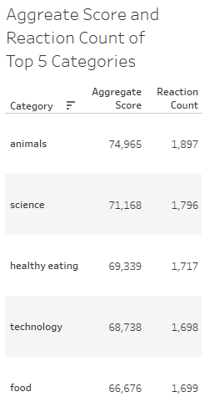
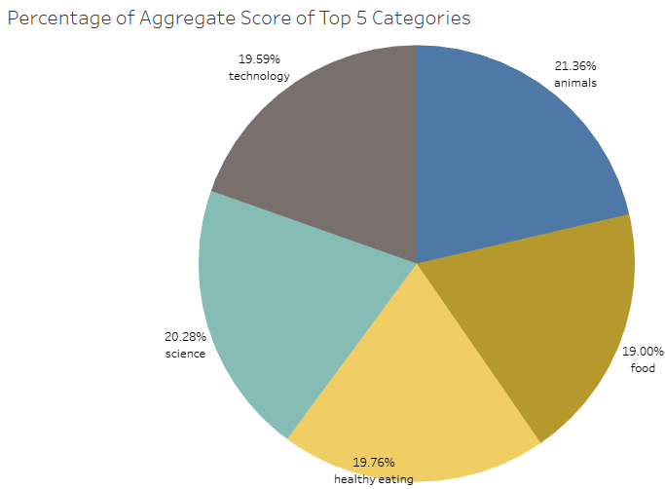

Slide 9
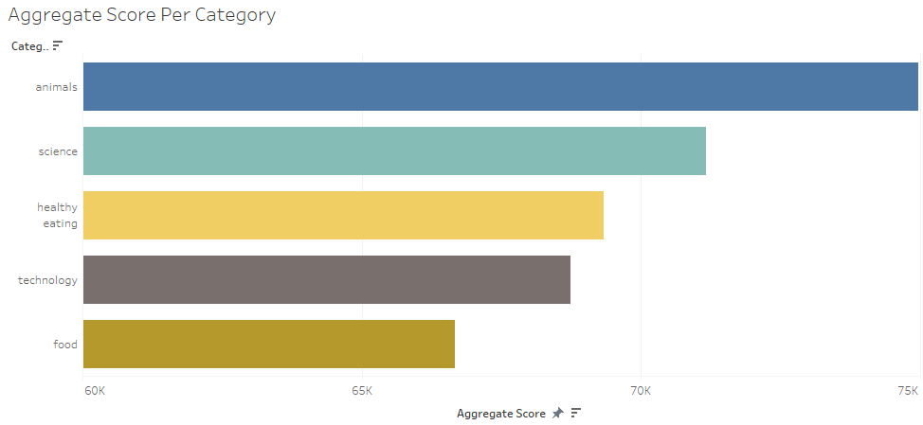

Slide 10

Top categories of content on Social Buzz are “Animals” and “Science”. This suggests users enjoy content relating to nature and reality.
Summary
Based on the top 5 categories, users of Social Buzz enjoy content which allows them to gain knowledge and improve their life. This is shown from the popularity of “Science”, “Healthy Eating” and “Technology”.
We have learnt about the types of people that use Social Buzz and understand the type of content they want to consume.

Slide 11
Thank you!
ANY QUESTIONS?

